Slide 1
Coastal Model Integration in NWM NextGen Framework for Total Water Level Forecasting
Phil Miller^{1,2}, Jason Ducker^{1,2}, Justin Singh-Mohudpur^{1,2}, Julio Zyserman^{1,2}, J Michael Johnson^{1,2}, Richard Gibbs³, Sean Horvath^{1,2}, Dong Ha Kim^{1,3}, Amin Torabi^{1,2}, Jurgen Zach^{1,2},T. Flowers¹, E.P. Clark¹
1 NOAA Office of Water Prediction, National Water Center, Tuscaloosa, AL, United States
2 Lynker Technologies, Boulder, CO, United States
3 University of Alabama, Tuscaloosa, AL, United States
Notes:
Goals: Transition NWM v3 TWL capability to NextGen Framework to improve modeling capabilities and system integration

Slide 2
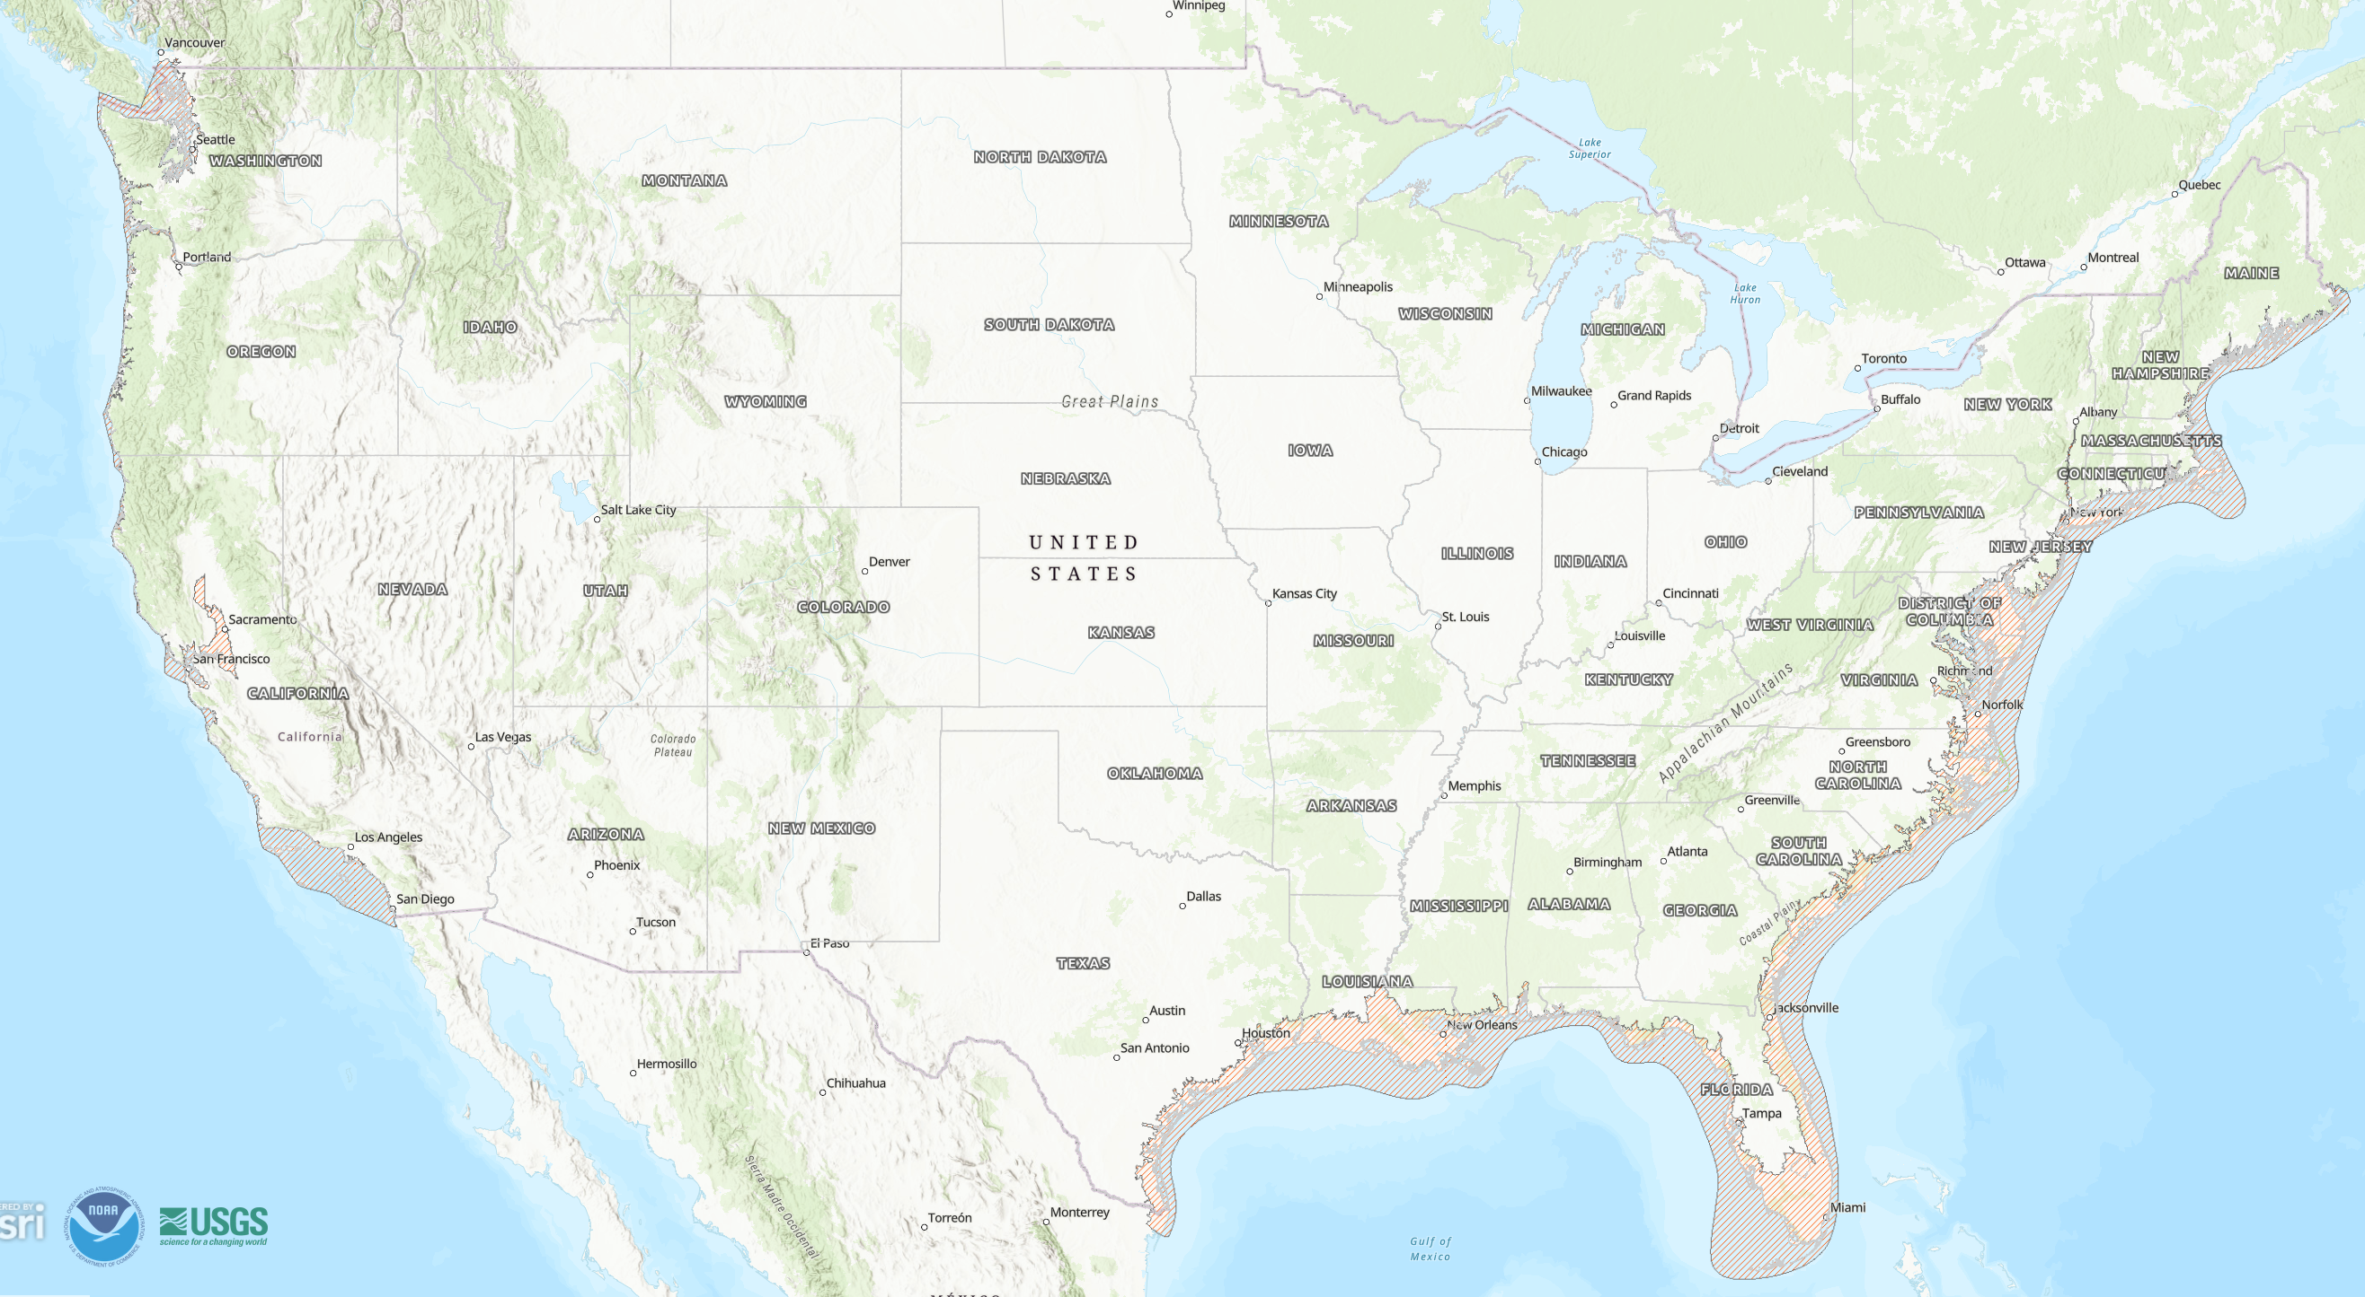
Coastal Modeling Zone
Notes:
Plus Great Lakes, Lake Champlain, Southern Alaska around Cook Inlet, Hawaii, Puerto Rico & US Virgin Islands
Effects of Tides, Winds, Storm Surge

Slide 3
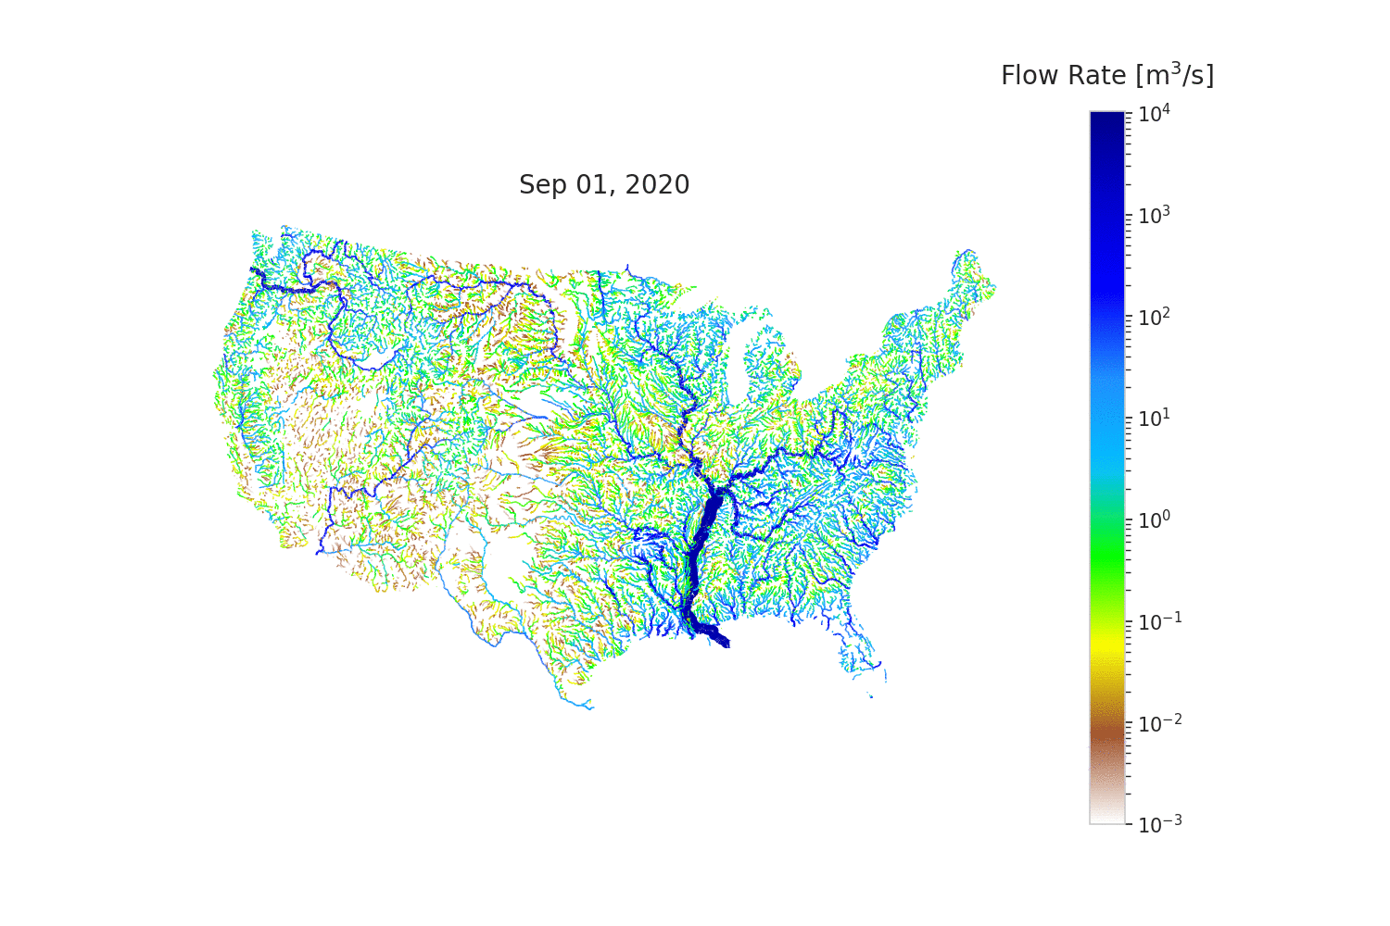
T-Route Channel Routing Network
Notes:
Catchment runoff models, driven by ngen

Slide 4
Components
Software
SCHISM: coastal model
T-Route: channel routing
Forcings Engine: data sources
ngen: NextGen model engine
Data
Hydrofabric: Nexus POI column
Coastal Meshes
POI/mesh element mappings
Meteorological forcings
Off-shore boundary conditions
Channel outflows

Slide 5
Components - Inland / Coastal Linkage
Software
SCHISM: coastal model
T-Route: channel routing
Forcings Engine: data sources
ngen: NextGen model engine
Data
Hydrofabric: Nexus POI column
Coastal Meshes
POI/mesh element mappings
Meteorological forcings
Off-shore boundary conditions
Channel outflows

Slide 6
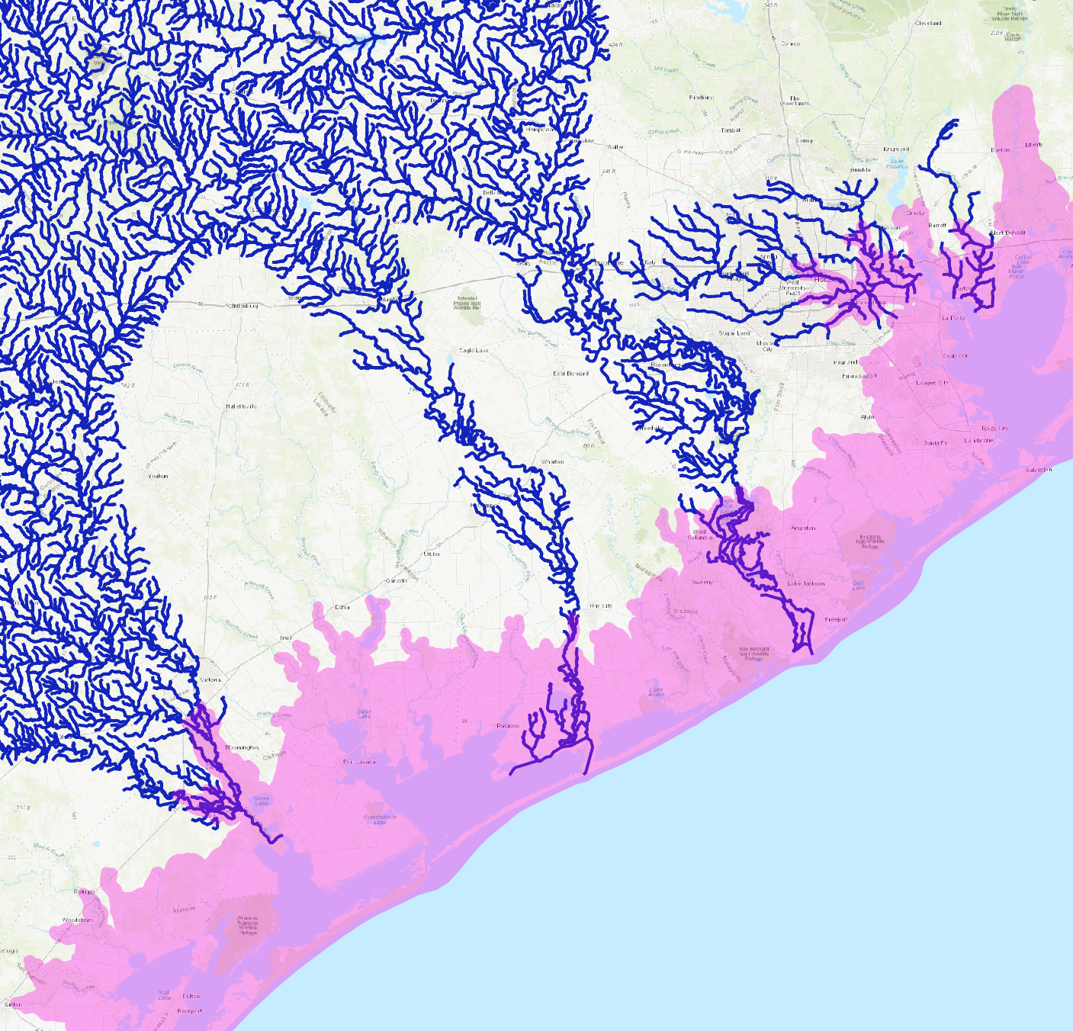
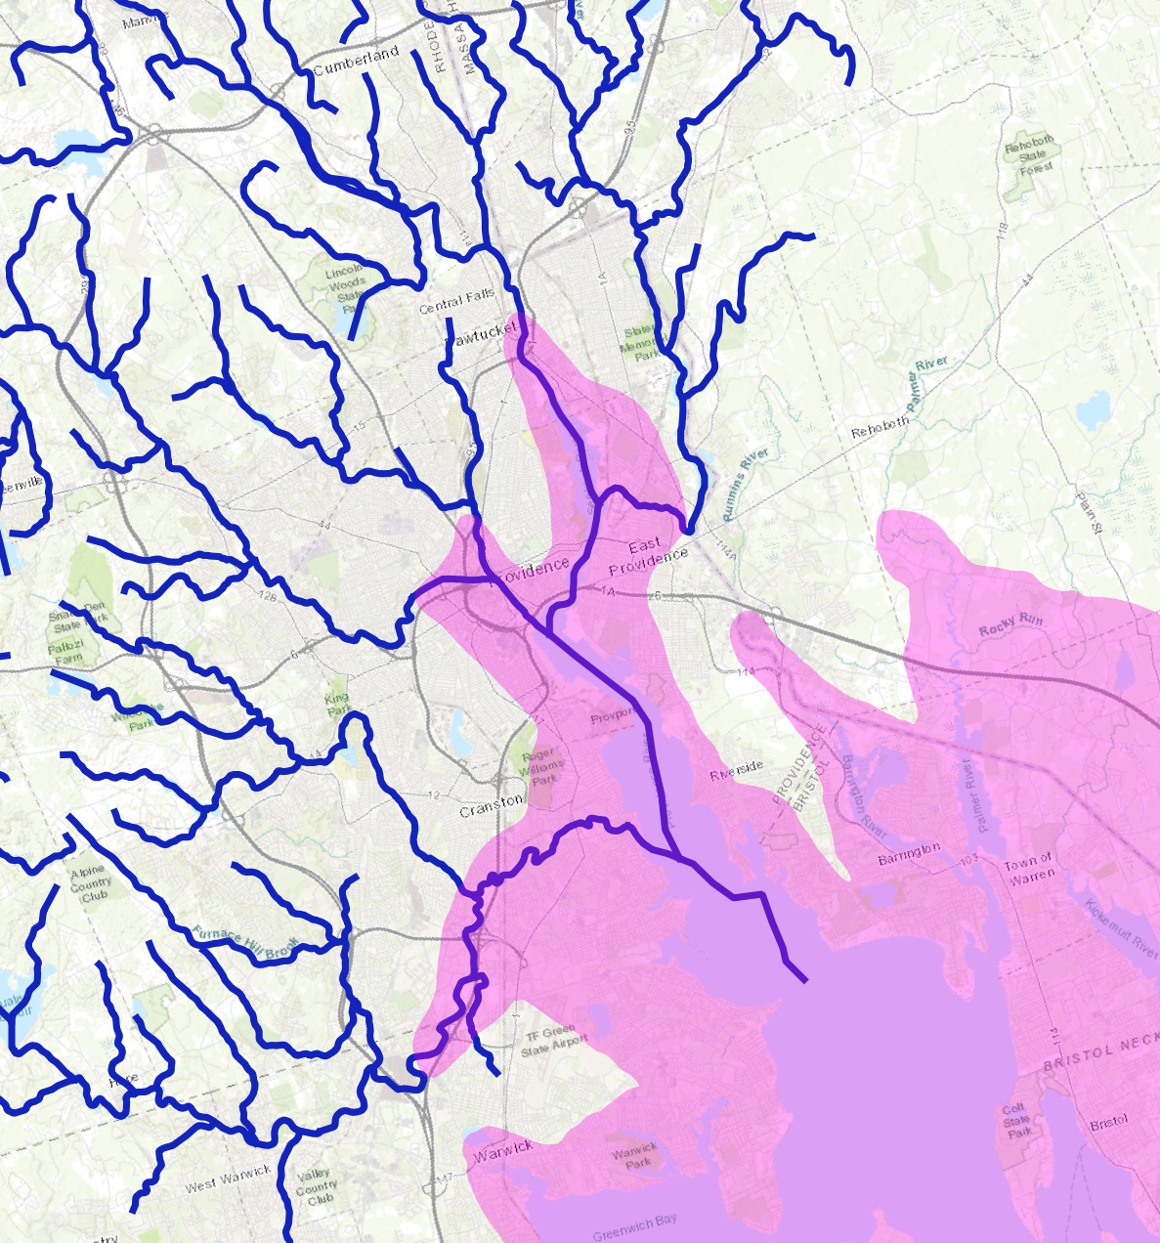
Channel / Coastal Linkage
Notes:
SCHISM domain mesh, t-route channels;
Hydrofabric and coastal mesh
Ngen mediating data passing of flows/boundary water depths

Slide 7
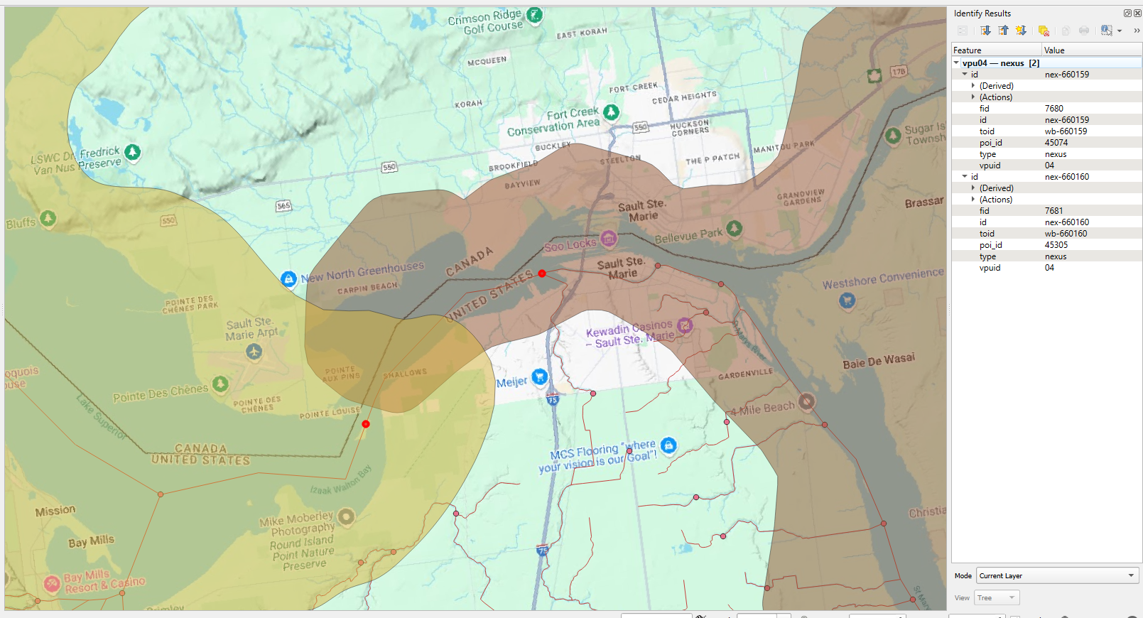
Nexus “Point of Interest” (POI) Labeling
Notes:
St Mary’s River – outflow from Lake Superior becomes inflow to the Lake Huron/Lake Michigan complex

Slide 8
Components - Inland / Coastal Coupling
Software
SCHISM: coastal model
T-Route: channel routing
Forcings Engine: data sources
ngen: NextGen model engine
Data
Hydrofabric: Nexus POI column
Coastal Meshes
POI/mesh element mappings
Meteorological forcings
Off-shore boundary conditions
Channel outflows

Slide 9
Components - Forcings
Software
SCHISM: coastal model
T-Route: channel routing
Forcings Engine: data sources
ngen: NextGen model engine
Data
Hydrofabric: Nexus POI column
Coastal Meshes
POI/mesh element mappings
Meteorological forcings
Off-shore boundary conditions
Channel outflows
Notes:
SCHISM modified to take BMI inputs, and not read from files directly
Forcings Engine produces unstructured mesh output using ESMF configured for each Coastal Domain mesh
Ngen loads pre-processed forcing data from NetCDF, or passes through data generated on-the-fly. Provides name mapping and unit conversion

Slide 10
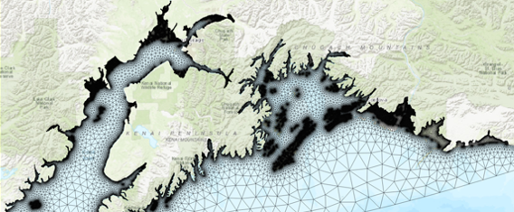

Forcings Engine
Surface Pressure
Wind Speeds
SCHISM
NextGen Forcings Engine
Node
Element
Retrospective Forcing Modules
Forecast
Forcing Modules
Rainfall
Notes:
Meteorological data regridded to SCHISM mesh using ESMF

Slide 11
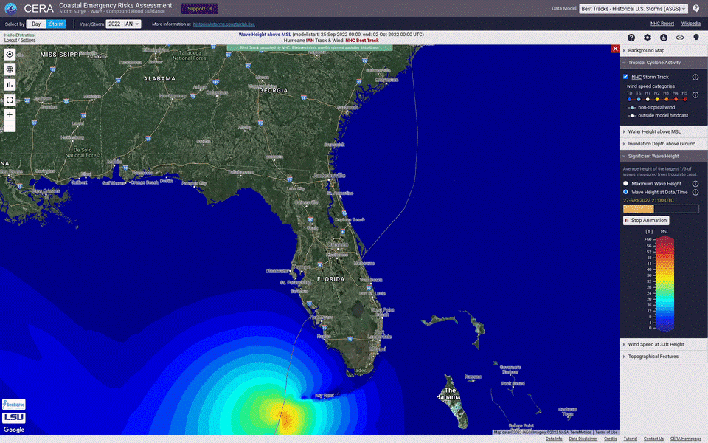
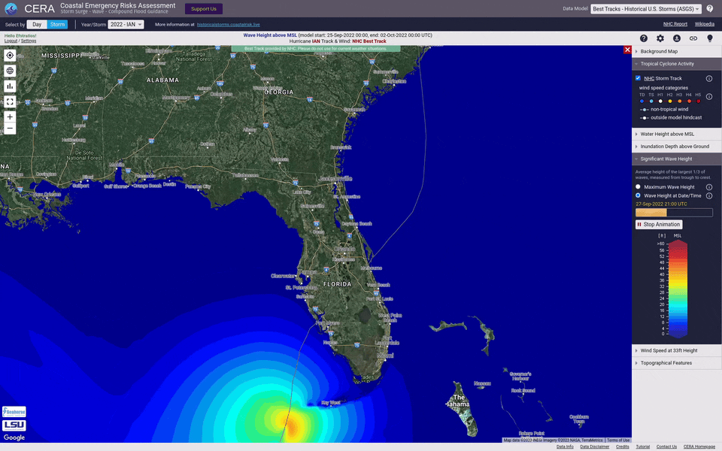
Offshore Forcings
SCHISM offshore water level boundary
SCHISM mesh ocean boundary
ADCIRC hindcast simulation demonstrating water level variability from Hurricane Ian approaching Southwest Florida in 2022.

Slide 12
Components – MPI Integration
Construct BMI instance
Create MPI Communicator
Get MPI identifier
Pass through BMI
Initialize as usual
model = construct(…)
comm = MPI_Comm_dup(MPI_COMM_WORLD)
comm_id = MPI_Comm_c2f(comm)
model->SetValue( “bmi_mpi_comm”, comm_id)
model->Initialize(config_file)
Notes:
Done for SCHISM and Forcings Engine
Broader use: allow other models integrated with NextGen to run in parallel, e.g. Noah-OWP-Modular

Slide 13
Phil Miller
philip.miller@noaa.gov

